Slide 1
Hydroxyapatite
Shubhankar Kapoor
Course: CE527

Slide 2
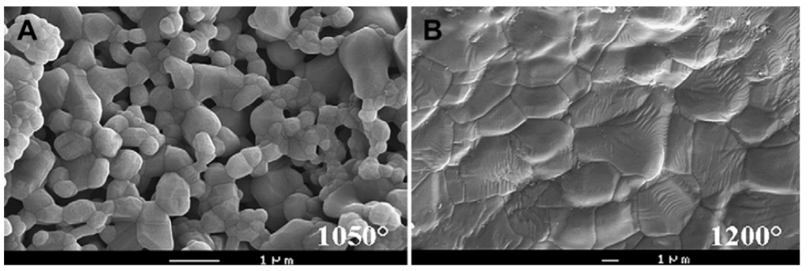
Outline
Calcium Phosphates
Hydroxyapatite
Teeth and Bone composition
Demineralization
Remineralization
Conclusion
SEM pictures of HAP bioceramics sintered at two temperature. 10nm. (Dorozhkin 2010)

Slide 3
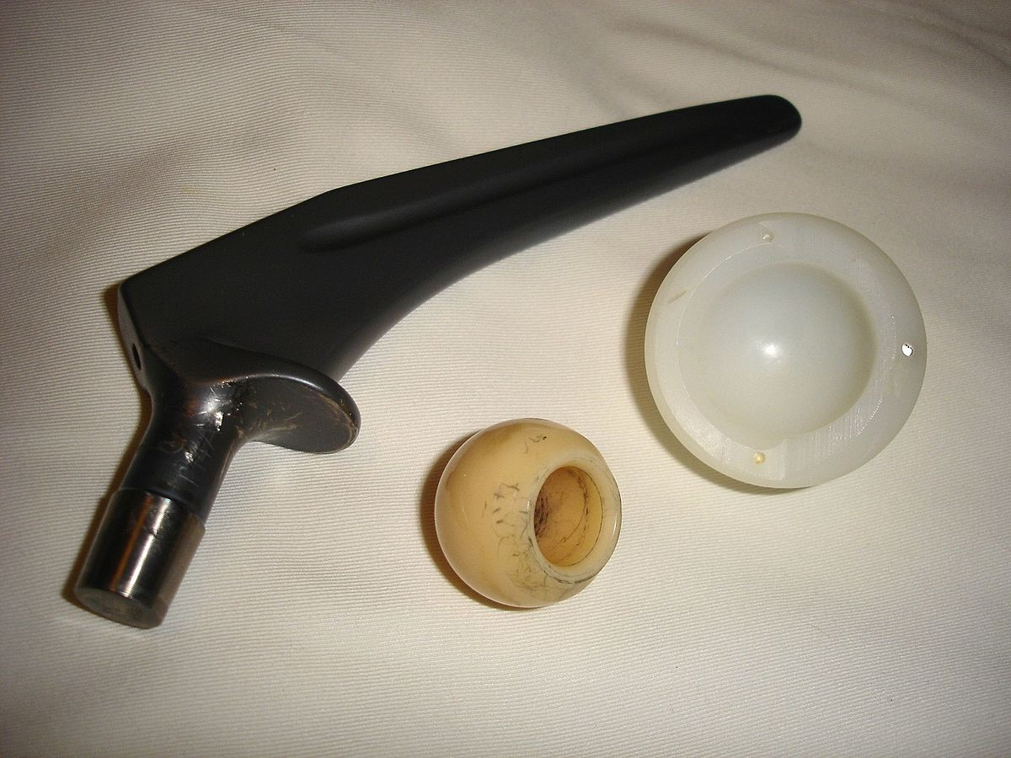
Bio-ceramics
Bioceramics are a class of biomaterials that have found a variety of role in the human body as surgical implants.
Bioceramics are not porcelain type ceramics, but are biocompatible, non-toxic, non-expanding biomaterials. They are usually chemically stable within the vast range of temperatures.
They are classified as:
Bio-inert
Bio-active and
Bio-degradable
A titanium hip prosthesis, with a ceramic head and polyethylene acetabular cup. Ref: Wikipedia

Slide 4
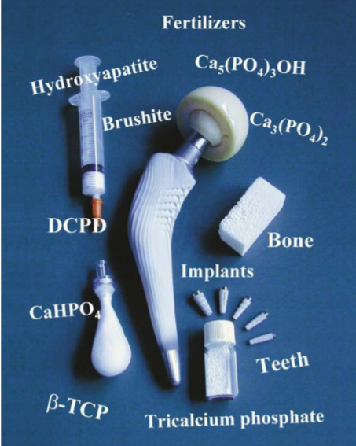
Calcium Phosphates
Calcium Phosphate is one of the most important inorganic compounds in the biological formations.
Calcium Phosphate salts, by definition, consists of three major elements:
Oxygen, present in the reduction state of -2
Phosphorous, present in the oxidation state of +5
Calcium, present in the oxidation state of +2
Because of the abundance of these chemical elements, it is expected to find calcium phosphate throughout the planet in various forms.
Mostly occurs as deposits of apatites in biological formations.
Apatite is generally classified as a compound containing calcium, phosphate, and either of fluoride, hydroxide group or chloride.
Dorozhkin, S. V., Calcium Phosphates and Human Beings. Journal of Chemical Education 2006, 83 (5), 713.

Slide 5
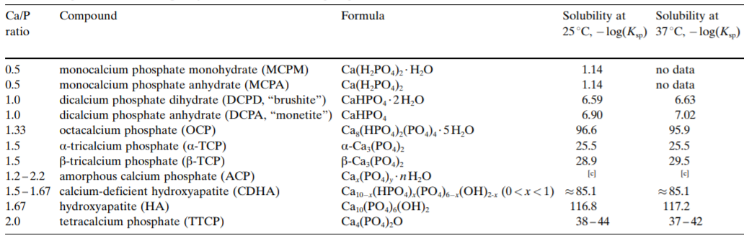
Calcium Phosphates
Examples of Calcium Phosphates with their Ca/P ratio.
S. Dorozhkin, Bioceramics of Calcium Orthophosphates. (2010), vol. 31, pp. 1465-1485.

Slide 6
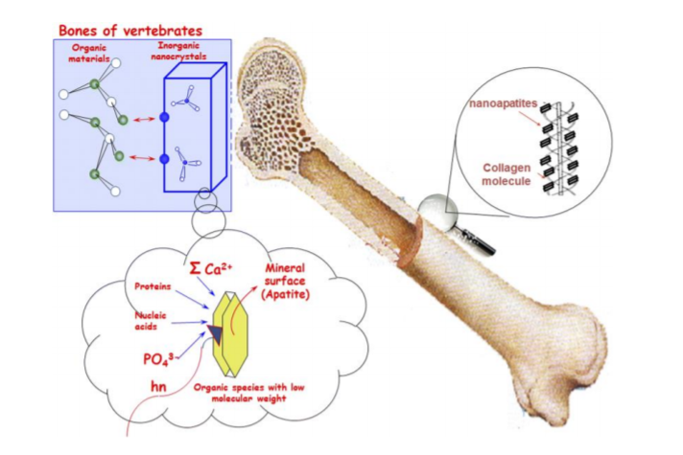
Hydroxyapatite
Hydroxyapatite (HAP) is the most stable form of calcium phosphate at normal temperatures and pH between 4 and 12.
One of the factors separating HAP from other calcium phosphates is its higher in-vivo stability.
HAP and other Calcium phosphate salts are formed by biomineralization which is a process where living organisms produce minerals which are required for their survival.
The hydroxyapatite in bones and teeth provides the body with unique functionalities like strength. It is biocompatible, non toxic, non inflammatory and osteoconductive in nature.
Vallet-Regi, M.; Arcos, D., Biological Apatites in Bone and Teeth. In Nanoceramics in Clinical Use: From Materials to Applications, 2nd Edition, 2016; Vol. 39, pp 1-29

Slide 7
Synthesis of Hydroxyapatite
Crystallization is the main force behind the formation of HAP.
As is the case with any type of crystallization process, the nucleation and crystal growth in a system of calcium phosphate is a function of supersaturation.
In-vivo methods
Biomineralization is the process via which various minerals are formed at a certain condition of temperature, pressure and pH in the biological systems
For the synthesis of HAP via the process of crystallization in the biological systems, some degree of supersaturation of the precipitating phase has to occur.
Some of the factors that lead to this mineralization are the concentration of the ions, solution pH, inhibitors and the structure of the supporting organic matrix.

Slide 8
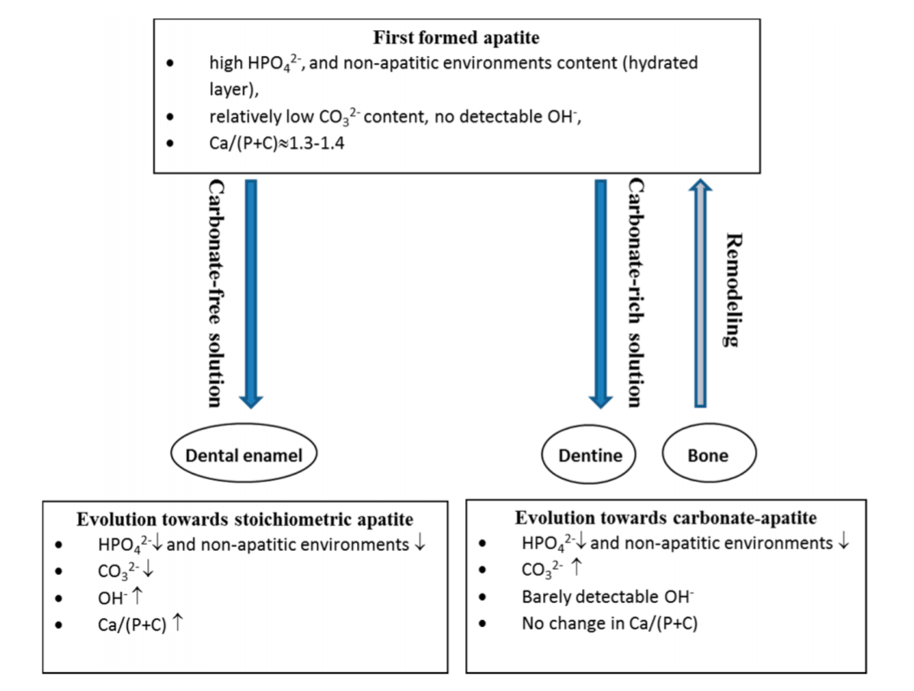
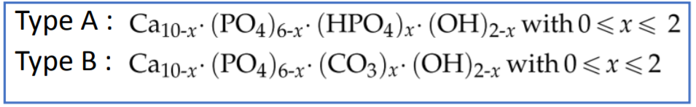
Synthesis of Hydroxyapatite
The maturation pathway of the apatites depend on the initial amount of carbonate present in the solution containing the ions for apatite formation.
Carbonate deficient solution gradually helps in the formation of stoichiometric apatite and carbonate rich solutions produce carbonated hydroxyapatite
The apatite hosts carbonate in two positions:
Hydroxyl sublattice producing type A carbonate apatite
Phosphate sublattice forming type B
C. Combes, S. Cazalbou, C. Rey, Apatite Biominerals. Minerals 6, 34 (2016).

Slide 9
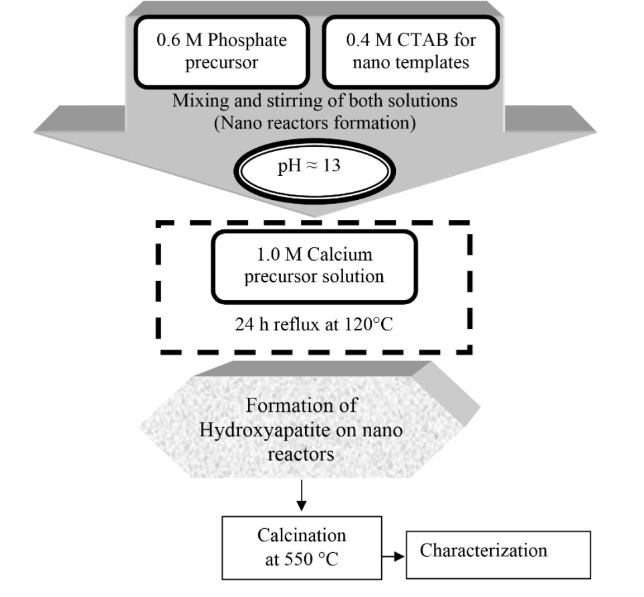
Synthesis of Hydroxyapatite
In-vitro methods
Several methods like layer hydrolysis, sol-gel crystallization, solid state reactions, plasma techniques and self assembly have been reported throughout the literature.
The formation of synthetic HAP crystals, from any method, proceeds via the formation of intermediate precursors phases (tricalcium phosphate and octacalcium phosphate) from the saturated solutions.
Although these synthetic procedures are advantageous due to low cost but leads to the formation of non-stoichiometric products.
These deviations are mainly due to inconsistencies in the crystal structure such as lattice vacancies and substitution of ions.
Flow diagram of procedure for the synthesis of nano hydroxyapatite. http://www.scielo.br/scielo.php?script=sci_arttext&pid=S1516-14392015000300468

Slide 10
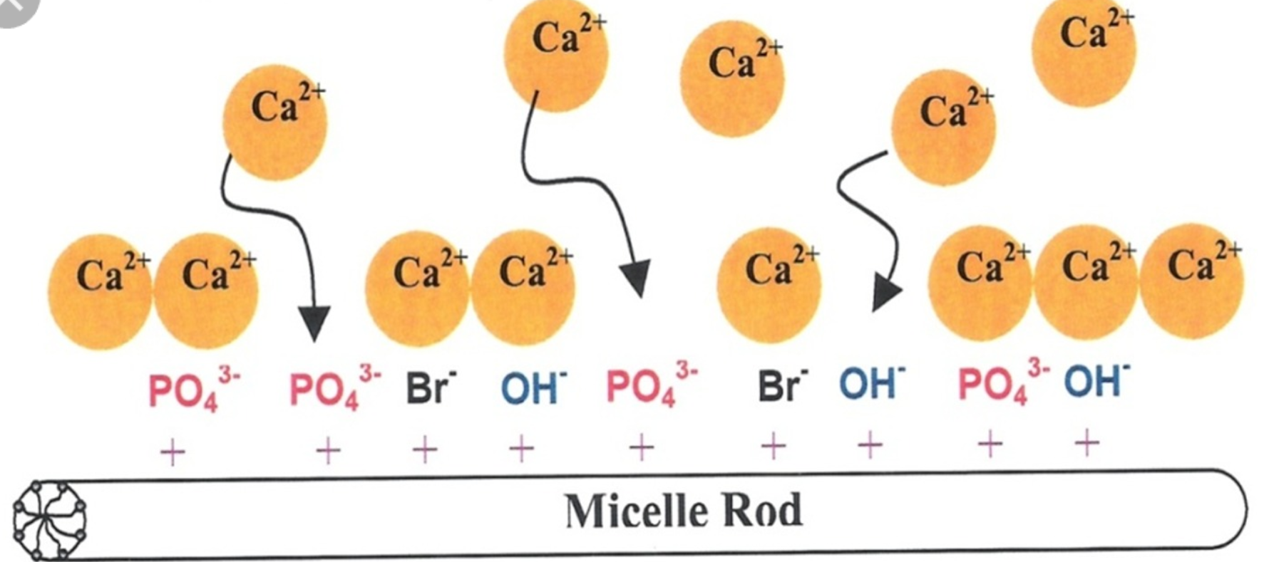
Synthesis of Hydroxyapatite
Cetyl trimethyl ammonium bromide (CTAB) is added to the water. This creates nano-reactors of micelles. High concentration of the surfactant, above the CMC, surfactant molecules to adopt a cylindrical shape.
The surfactant solution containing micelles is mixed with the phosphate precursor solution
Adsorption of phosphate onto the micelle surfaces during the surface treatment of micelles occurs.
Subsequently, with the addition of calcium precursor solution, Ca²⁺approaches the surface of micelles containing phosphate to form calcium phosphate as surface double layer
By adjusting to the required pH, temperature, the conversion of calcium phosphate to hydroxyapatite take place.
Schematic of hydroxyapatite phase formation. http://www.scielo.br/scielo.php?script=sci_arttext&pid=S1516-14392015000300468

Slide 11
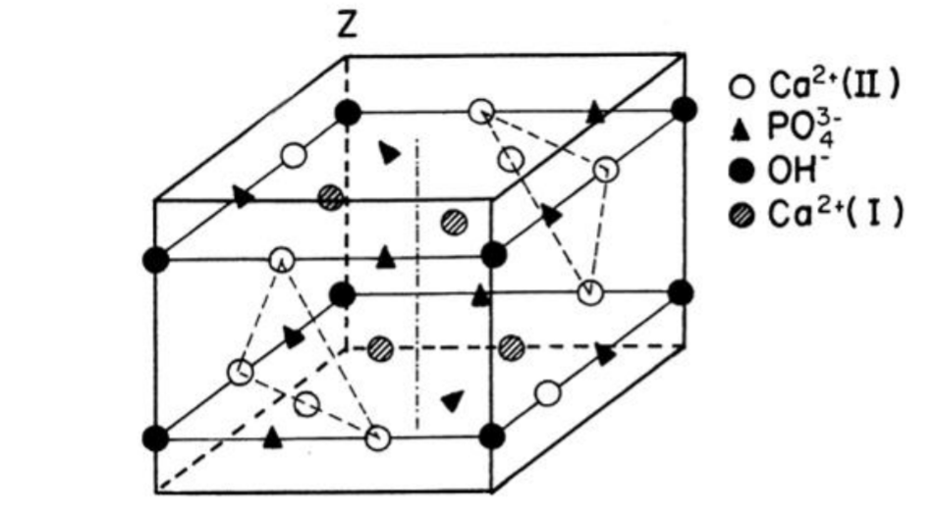
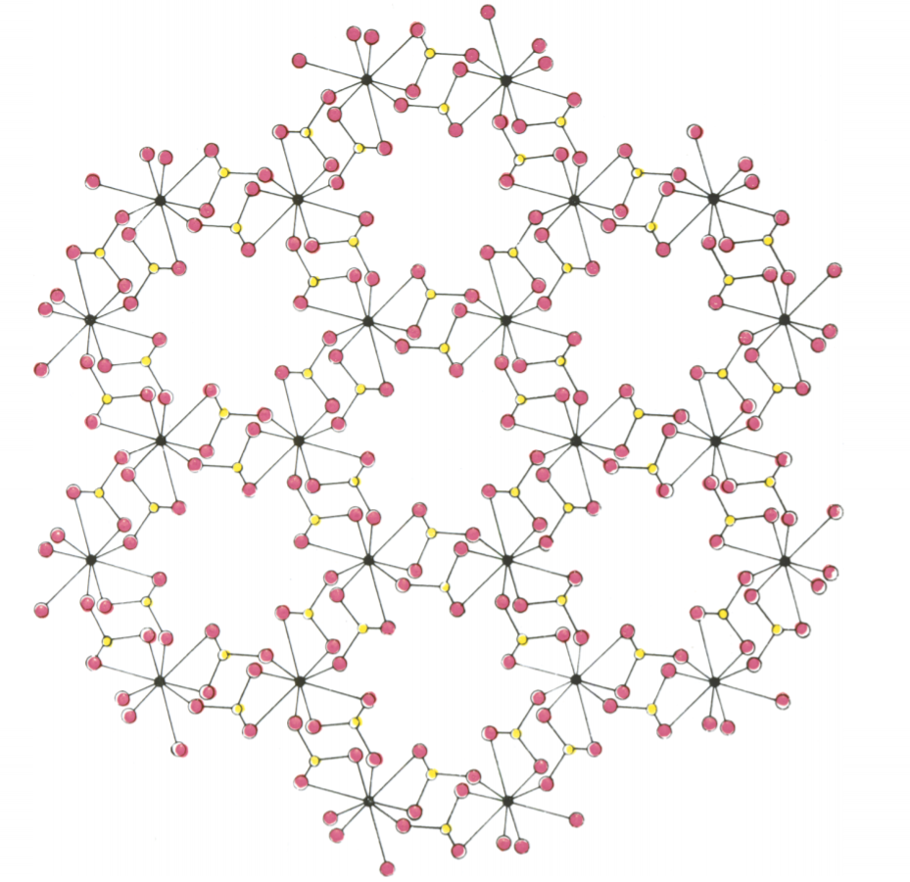
Crystal Structure of Hydroxyapatite
Stoichiometric Ca/P ratio of 1.67.
The chemical formula of HAP is Ca₁₀(PO₄)₆(OH)₂ and the lattice parameters of unit crystals are a = b = 9.42Å and c = 6.87Å.
The hydroxyapatite crystals in bone and teeth are very highly ordered and oriented.
J. W. Larry Hench, An introduction to Bioceramics. (1993), vol. 1.
Arrangement of the PO₄, O₂ atoms around Ca atoms. (Legend: Pink: Oxygen atom, Black: Calcium atoms, Yellow: Phosphate atoms)
D. B. M. C. A. Beevers, in Mineralogical Magazine. (1945), vol. 27.

Slide 12
Differences between Biological Occurring and Synthetic HAP
Biological HAP and Synthetic HAP have minor differences which corresponds to major functional differences between the two.
These minor differences, which arises due to the way in which they are form, involves imperfections in the crystal structure in the biologically occurring HAP.
Specifically, the site of Ca²⁺, could be occupied by monovalent or bivalent ions such as Mg^{2+,} Na⁺, K⁺, Cl⁻, F⁻ and PO₄ tetrahedral sites could be substituted by CO₃²⁻, As, S and OH⁻ ion by CO₃²⁻, Cl⁻, F⁻.
HAP is always in a dynamic state and is removed and redeposited by cellular activity, whereas synthetic HAP can only be modified by physiochemical processes.

Slide 13
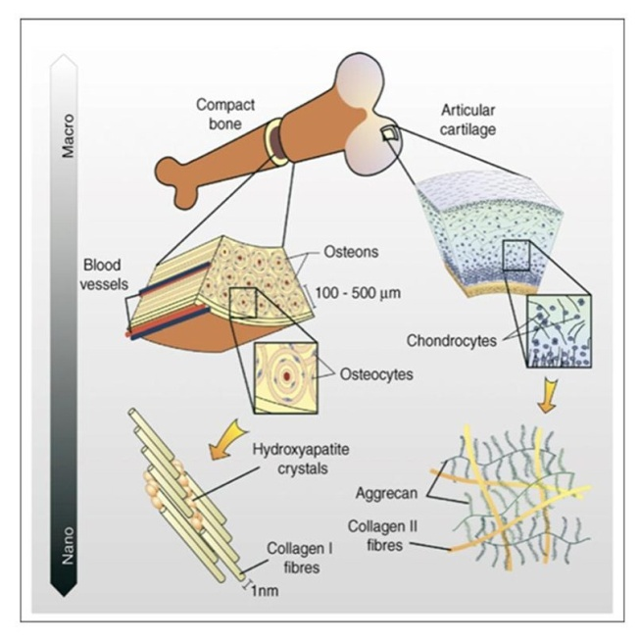
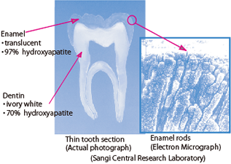
HAP in Bones and Teeth
HAP in teeth. http://www.sangi-co.com/
HAP in bones. http://article.sapub.org/10.5923.j.ajbe.20130306.04.html

Slide 14
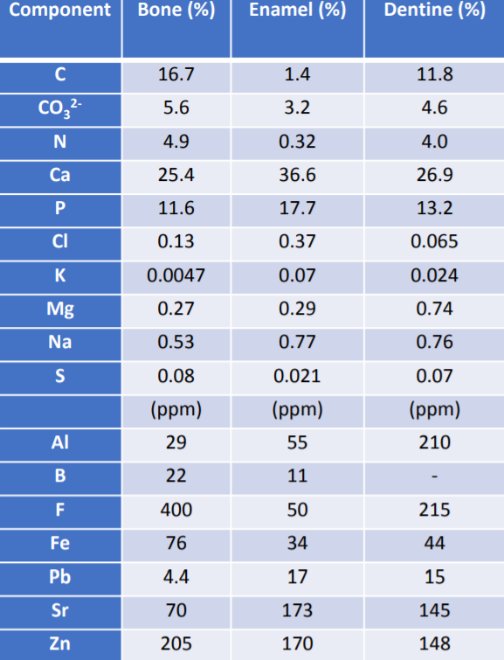
Interest in Bones and Teeth
Human bone apatite: Ca_{8.1} Mg_{0.2} (PO₄)_{4.3} (HPO₄)_{0.5} (CO₃)_{1.2} (OH)_{0.3}
Human dentine apatite: Ca_{8.0} Mg_{0.4} (PO₄)_{4.4} (HPO₄)_{0.7} (CO₃)_{0.9} (OH)_{0.4}
Human enamel apatite: Ca_{8.8} Mg_{0.1} (PO₄)_{4.9} (HPO₄)_{0.6} (CO₃)_{0.5} (OH)_{0.9}
N, O and C constitute the main organic component of the apatites.
Ca , P, carbonates and trace elements constitute the bulk of the inorganic constituent of bones and teeth.
Due to the presence of minor and trace elements no exact chemical formula for biological apatites are available.
The average composition has been derived based on the simplified model which do not account for the presence of type A carbonate replacing OH⁻ ions and the sodium content.

Slide 15
Interest in Bones and Teeth
S. No | Diff | Bone and Dentine | Enamel
1. | Carbon Content | High carbonate content and higher number of inorganic substitutions | Low carbonate content and lower number of substitutions.
2. | Organic Content | Cells, Organic tissues, non-collagenous proteins are present | Total organic content <3%
3. | Structure | Plate like nanocrystals | Needle like nanocrystals
4. | Dimension | 50 nm x 25 nm x 10 nm | Dimensions vary with species
5. | Packing | Agglomerated as parallel platelet crystals | Organized as rods of densely packed structures
6. | Regeneration | Can be regenerated over time | Very low regenerative power
7. | Hardness | 1-2 GPa | 3.5-5.0 GPa
8. | Elastic modulus | 17-23 GPa | 80-100 GPa

Slide 16
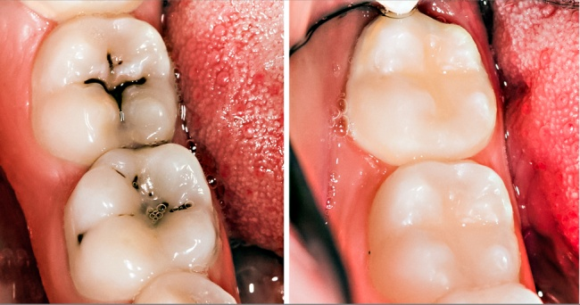
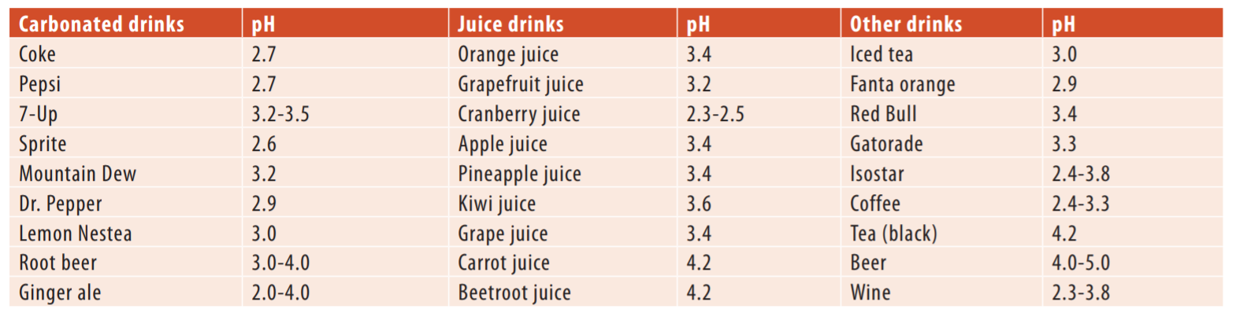
Demineralization in Teeth
Demineralization is a process which reduces the number of mineral ions from HAP crystals of in the hard tissues, for example, in enamel, dentin, and bone.
It leads to a substantial loss of mineral ions from the surface of the tissue. In teeth, it leads to the cavities and tooth decay whereas in the bone, it leads to osteoporosis.
Example of tooth decay on the left and a healthy tooth on the right (from http://giggag.com/post/36353)
Y.-F. Ren. (The Academy of Dental Therapeutics and Stomatology, 2011), pp. 76-82.

Slide 17
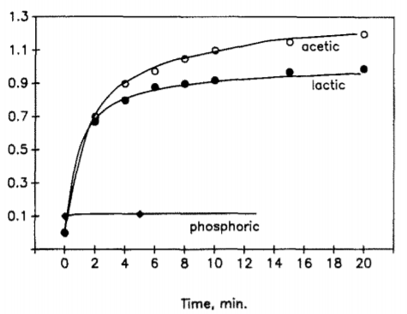
Causes of Demineralization
Causes of Demineralization
Dietary acid consumed via food or drinks.
Microbial attack from bacteria present in the mouth.
The critical threshold pH that has been known to cause demineralization is 5.5.
Streptococcus mutans, Streptococcus sobrinus and Lactobacillus are carcinogenic pathogens which can withstand very low levels of pH. The acid softens the tissues by solubilizing the calcium and the phosphates.
Change in calcium concentration as a function of time. H. C. Margolis, E. C. Moreno, Kinetics of hydroxyapatite dissolution in acetic, lactic, and phosphoric acid solutions. Calcified tissue international 50, 137-143 (1992).

Slide 18
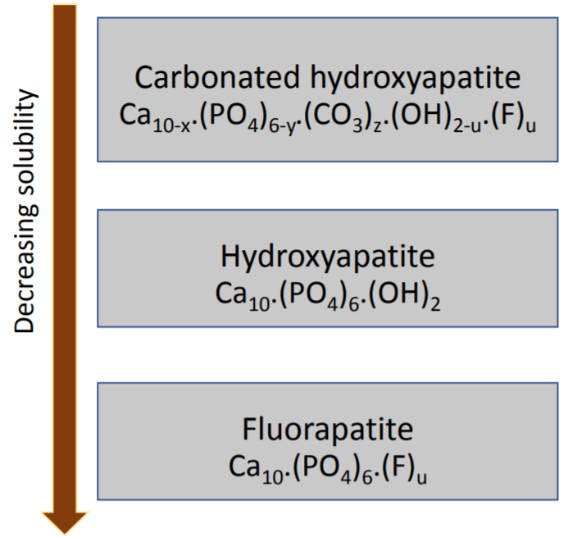
Acid Dissolution
Direct Pathway:
Hydronium ions from the acids bond with phosphate and carbonate in the enamel.
Anions are released in the solution as a result of chemical etching.
Chelation:
The COOH group of an acid like citric acid or phosphate acid, is dissociated to form H⁺ and H₃O⁺.
This happens via the formation of soluble chelate complex with three calcium ions and is strictly dependent on the strength of the anion.
This results in a COO⁻ anion to cause calcium chelation.

Slide 19
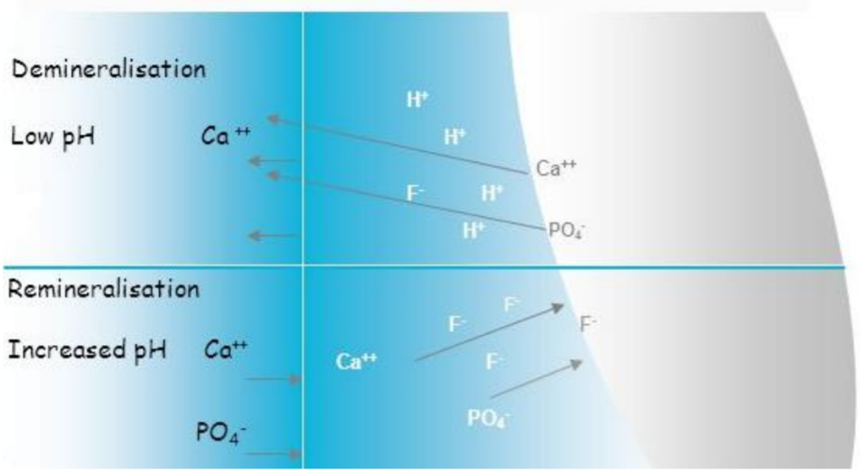
Remineralization of Teeth
The process of arresting and reversing the demineralization is called Remineralization.
Demineralization can be arrested particularly in the early stages of tooth decay.
Some of the techniques involves fluoride therapy, diet control, probiotic bacteria and the use of dental fillers containing HAP or other calcium phosphate compounds
http://www.dimensionsofdentalhygiene.com/2009/07_July/Features/The_Dynamic_Process_of_Demineralization_and_Remineralization.aspx

Slide 20
Remineralization Techniques
Fluoride Therapy:
Fluorides are the most favoured remineralizing agent.
Fluorine displaces the calcium present in the biologically occurring HAP, forming fluorapatite (FAP).
decrease the enzymatic activity of the bacteria which produces lactic acid and act as catalyst to increase rate of mineralization.
It is therefore, that fluorine is added to the drinking water. The Fluoride assists remineralization of enamel by acting as a catalyst with the phosphate ions dissolved in the saliva. Care should be taken not to exceed the overuse of fluoride.
Two main advantages of FAP:
1. It has much lower solubility than the original or demineralized FAP.
2. It forms solid state solution with HAP, by displacing OH⁻ ion.

Slide 21
Remineralization Techniques
General Regimen for carrying out remineralization experiment:
Mechanical properties of the dentin/enamel are measured/
Demineralization is performed on the samples with acidic/etching agents
A coating is applied to the demineralized surface.
Sample are added to the remineralization solutions for days/weeks
Final mechanical properties are measured.
Composites containing Hydroxyapatite:
Amorphous Carbonate Phosphate (ACP) releases significant amount of calcium and phosphate ions, thus arresting demineralization.
Coupling agent such as silicon and zirconium enhanced the remineralization potential of ACP.

Slide 22
Remineralization studies
Specimen placed in 15 ml of demineralizing solution of the composition 2.2 mM CaCl ₂ , 0.05 M lactic acid, and 0.5 ppm F⁻ adjusted to pH 4.5 with 50% NaOH for 48 hours.
Remineralization regimen (Two solutions were prepared):
Demineralized specimens were coated with 10% aqueous slurry of nanohydroxyapatite and immersed in artificial saliva for 10 days
2% neutral sodium fluoride solution was prepared by dissolving 20 g of sodium fluoride powder in 1 l of distilled water for 10 days.
Results
Enamel surface treated with nanohydroxyapatite
Study by Swarup et. al.
Surface zone mineral content of the enamel before and after remineralization
Enamel thickness before and after remineralization

Slide 23
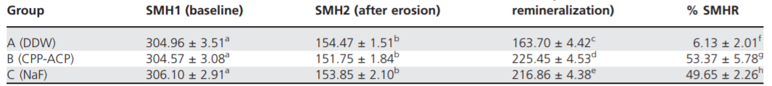
Remineralization studies
Study by Zhang et. Al.
Remineralization study by casein phosphopeptide-amorphous calcium phosphate(CPP-ACP)
Remineralization by Artificial saliva. Specimens were divided into 3 groups:
Group A: distilled and deionized water group (the DDW group, negative control)
Group B was a CPP-ACP creme group (the CPP-ACP group, the test group)
Group C was the 500 ppm NaF solution group (the NaF group, positive control)
Surface microhardness recovery( SMHR% was measured) for each group.
Enamel SMH at baseline, after erosion, and after remineralization and percentage of SMHR
Zhang, Q.; Zou, J.; Yang, R.; Zhou, X. D.,. International Journal of Paediatric Dentistry 2011, 21 (5), 374-381

Slide 24
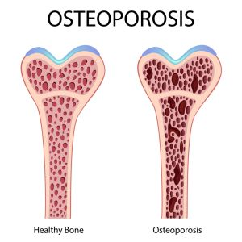
Demineralization–Remineralization in Bone
The mineralization process of the bone occurs via the process of bone remodelling wherein the mature tissues are replaced from skeleton by new bone tissue.
The mineralization rate of bones is 1 μm/day for humans.
Demineralization results in the disruption in the physiochemical process of bone remodelling by change in the contribution of the osteons.
Small decrease in mineralization results in large decrease in the strength of the bone resulting in the osteoporosis, osteogeneis imperfecta and other diseases
Bone cements/composites with remineralizing action have been developed and are being used widely in orthopaedic surgeries. On such composite is Poly(methylmethacrylate) (PMMA)
HAP is also used as filler with composites to form nondegradable cements. These HAP bone composites have been reported to exhibit bone-binding ability and enhanced cellular activity.
http://www.drsusanjamieson.com/disease-prevention/world-osteoporosis-day/

Slide 25
Questions?

